Slide 1
Lecture 5: Proving Techniques in Diff Geo—Using examples
Math 142
Prof. Gu

Slide 2
Example 1:
Assume all normals of a parametrized curve pass through a fixed point. Prove that the trace of the curve is contained in a circle.
Need to draw a picture and understand if it would not be a circle, then some normals would not pass the fixed point. Viewing the tangent vector and the normal are attached to a point on the curve. Moving the normals so they will pass a fixed point forces the the curve going around to form a circle.

Slide 3
Work out details on the board.
Please see attached sheet for the detailed proof.
Let the students to observe the techniques we used in this proof.

Slide 4
Example 2
Show the shortest path between two fixed points is a straight line segment between these two points.
Let the students work on the board first since some of them know using the variational method to solve this problem.
Solution (For examples):
http://math.stackexchange.com/questions/181110/the-shortest-distance-between-any-two-distinct-points-is-the-line-segment-joinin
http://www.instant-analysis.com/Principles/straightline.htm

Slide 5
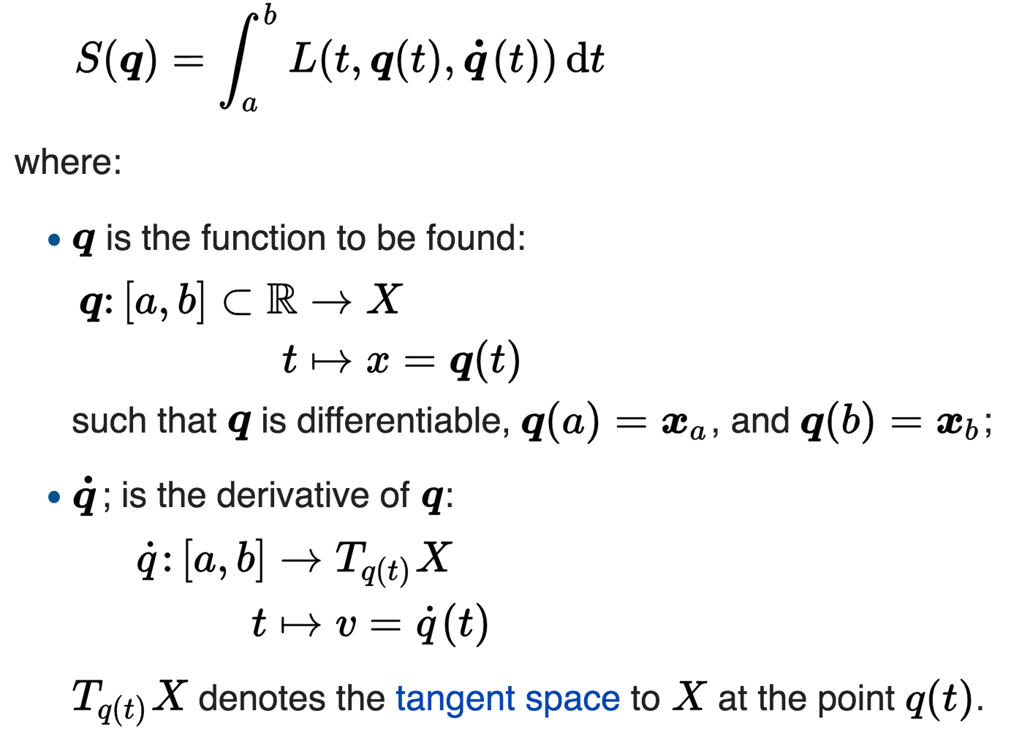
Using Euler-Lagrange Equation
The Euler–Lagrange equation is an equation satisfied by a function q of a real argument t, which is a stationary point of the functional

Slide 6
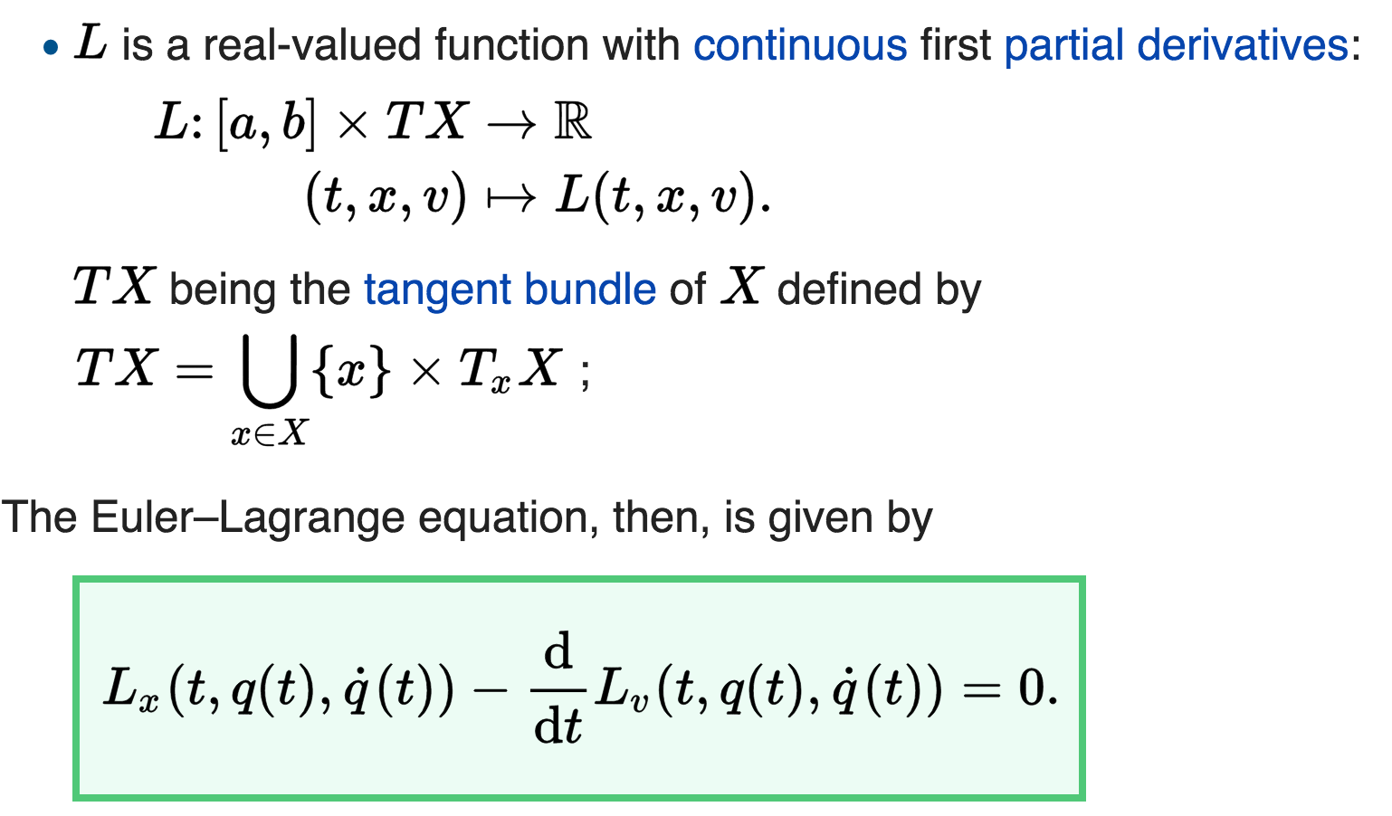
Where L_{x} and L_{v} denote the partial derivatives of L with respect to the second and third arguments, respectively.

Slide 7

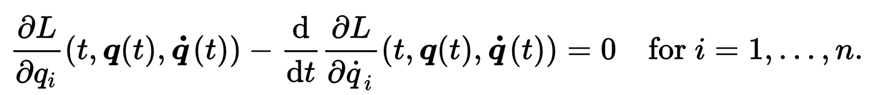

Slide 8
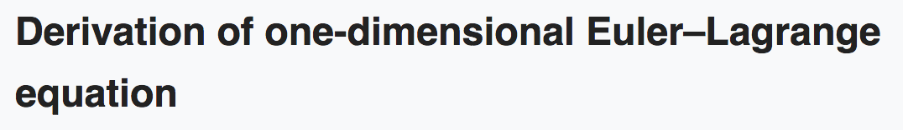
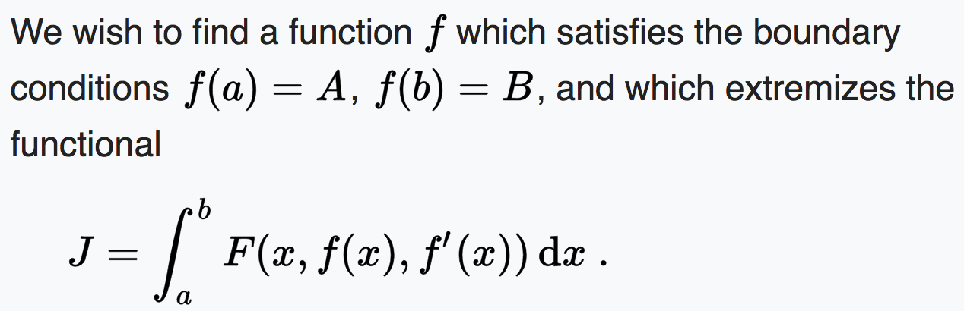
The derivation of the one-dimensional Euler–Lagrange equation is one of the classic proofs in mathematics. It relies on the fundamental lemma of calculus of variations.

Slide 9
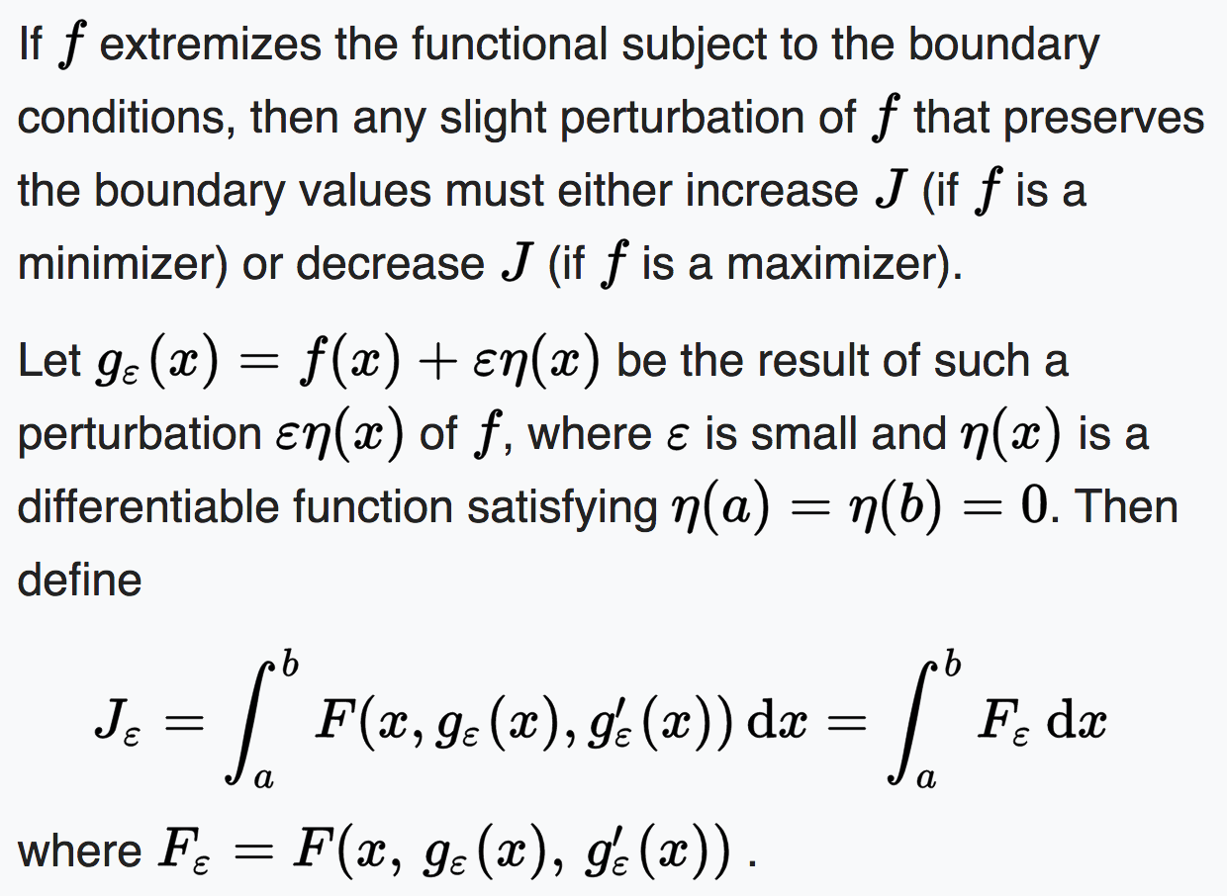

Slide 10
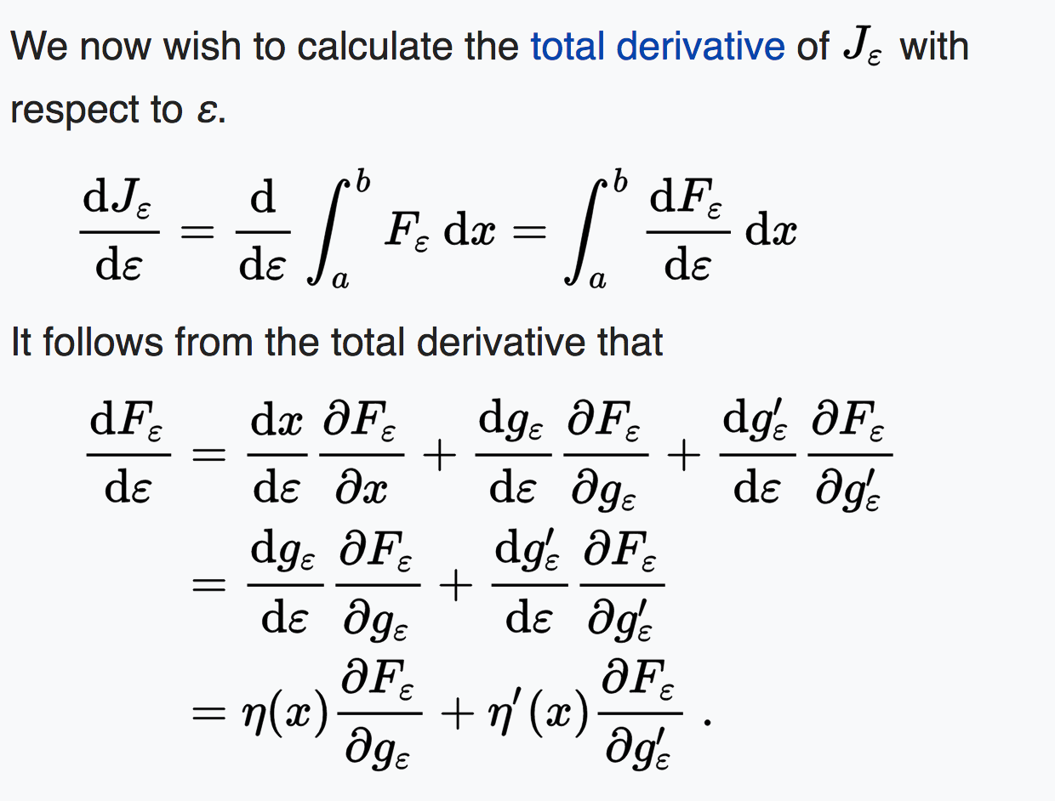

Slide 11
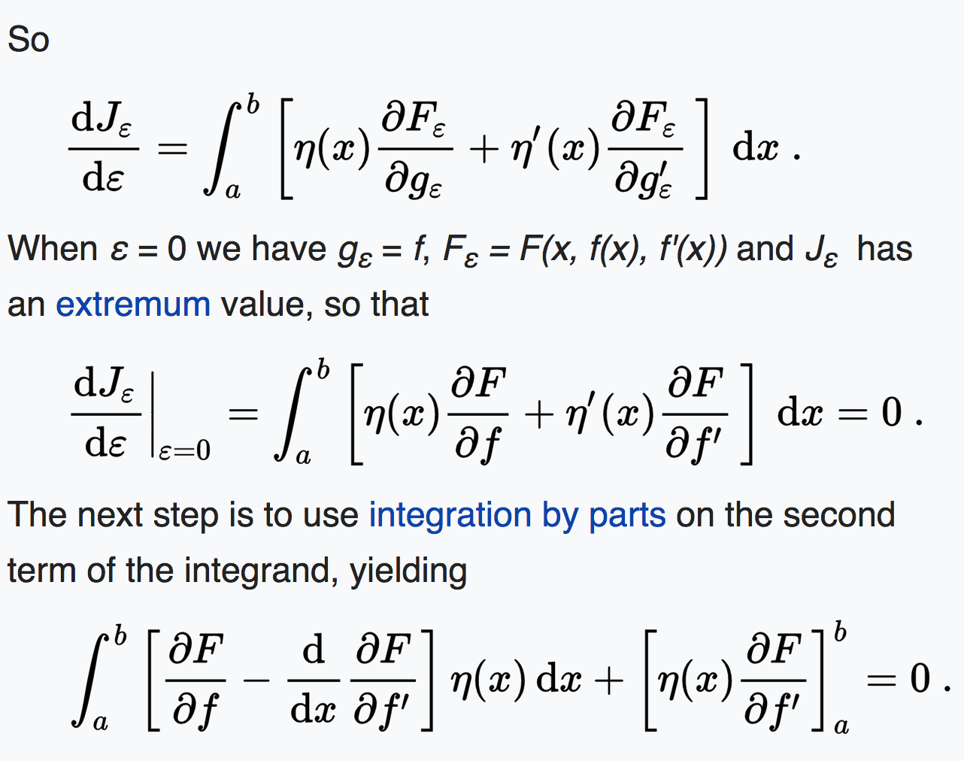

Slide 12
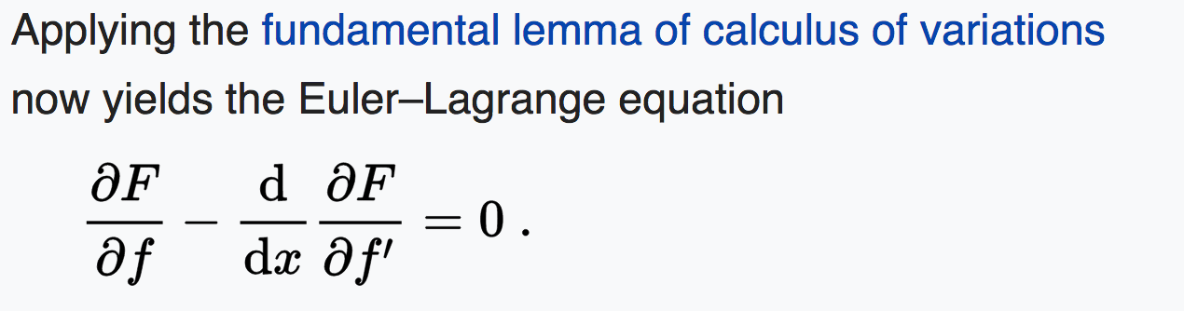

Slide 13
Example: Show the shortest path between two points is a straight line
I.e. finding the real-valued function f on the interval [a, b], such that f(a) = c and f(b) = d, for which the path length along the curve traced by f is as short as possible

Slide 14
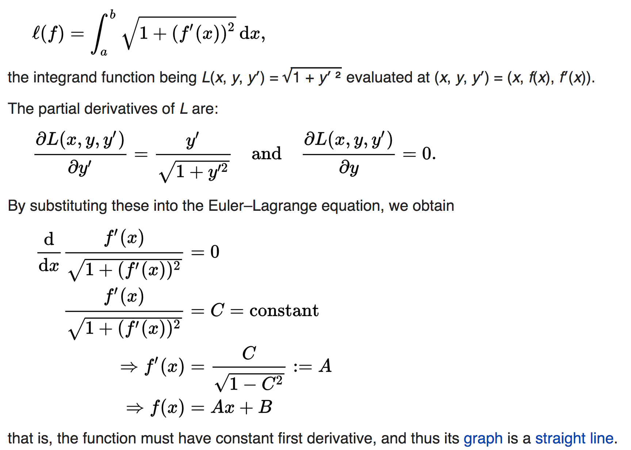
Example:

Slide 15
Our proof—Using Some Geometric Observation
Work on the board.
For the details, please see the attached paper.
Let the students to observe the techniques we used.

